Slide 1


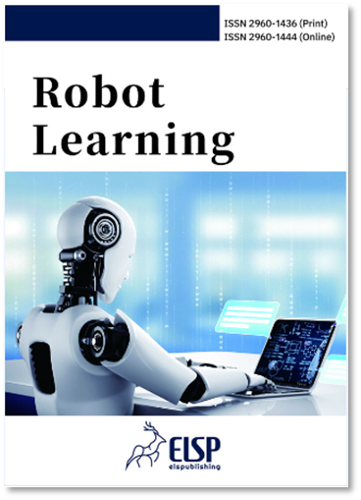










Robot Learning
Scope
Learning enhanced perception for robotics
Learning enhanced robot planning
Learning enhanced robot manipulation
Learning enhanced robot control
Learning method for human-robot coordination
Learning method for multi-robot cooperation or confrontation
Learning method for self-driving
Learning based robotic warehousing
Learning enhanced intelligent transportation
Learning method for bionic robotics and medical robotics
Learning method for UAV and USV
Deep learning, imitation learning and reinforcement learning for robotic system
Sim-to-Real transfer for robotic applications
Dataset, benchmark and simulator for robotic learning
Applications for robotic learning
Editor-in-Chief
Prof. Dr. Hesheng Wang
Shanghai Jiao Tong University, China
Editor-in-Chief
Prof. Chenguang Yang
University of Liverpool, UK
Quarterly
Online Immediately and continuously
elspub.com/journals/robot-learning/home/
Why publish with us
E-mail: rl@elspub.com
International Editorial Board
Rigorous Peer Review
Targeted JIF > 4
APC Waived until 2026
Submission: jms.elspub.com
Twitter: @RobotL26773
Early Career Editorial Board Recruitment
Website
Submission

